Slide 1
File - Definition
A file is a named collection of related information that is recorded on secondary storage such as magnetic disks, magnetic tapes and optical disks.
In general, a file is a sequence of bits, bytes, lines or records whose meaning is defined by the files creator and user.
A file can have several attributes and fixed kind of access methods

Slide 2
File Attributes
Name – only information kept in human-readable form
Identifier – unique tag (number) identifies file within file system
Type – needed for systems that support different types
Location – pointer to file location on device
Size – current file size
Protection – controls who can do reading, writing, executing
Time, date, and user identification – data for protection, security, and usage monitoring

Slide 3
File Operations
Create
Write – at write pointer location
Read – at read pointer location
Reposition within file - seek
Delete
Open(F_{i}) – search the directory structure on disk for entry F_{i}, and open the corresponding file
Close (F_{i}) – move the content of entry F_{i} in memory to directory structure on disk

Slide 4
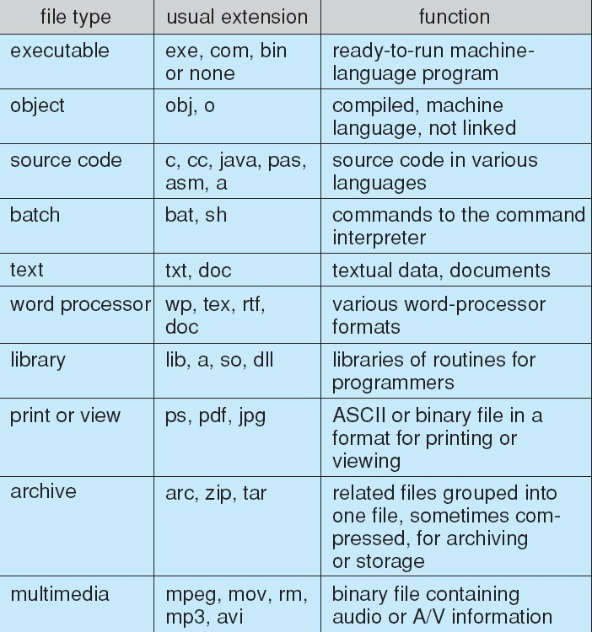
File Types

Slide 5
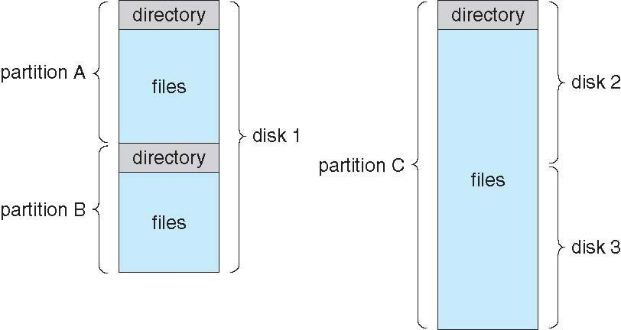
File System Organization

Slide 6
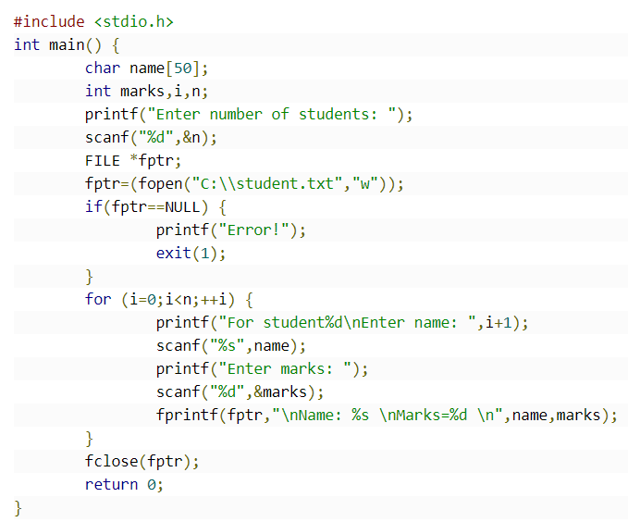

Slide 7
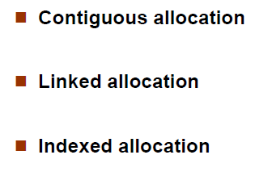
Topics to be Covered
File Allocation

Slide 8
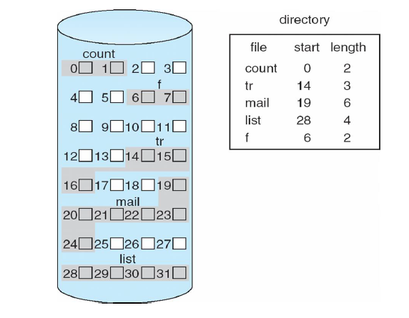

Slide 9

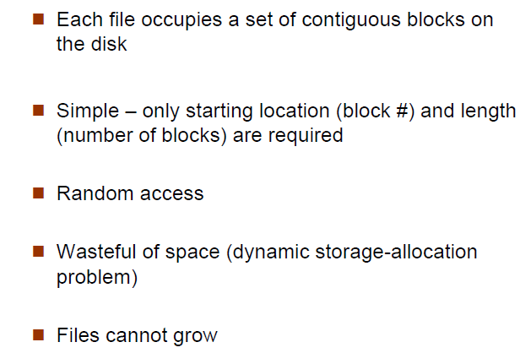

Slide 10

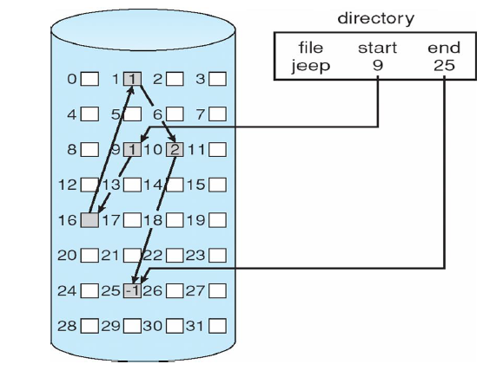

Slide 11

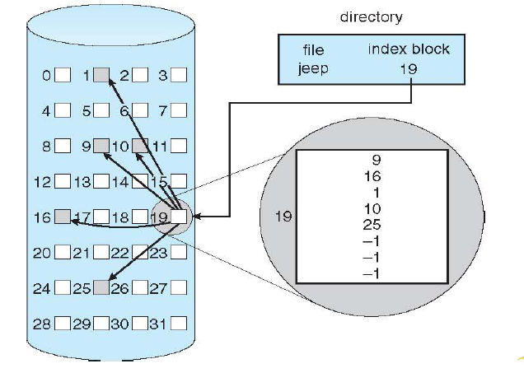

Slide 12
